Slide 1
E-SPLOST V
On May 20, 2014 the voters of Paulding County will be asked to extend the penny sales tax that is helping build classrooms, improve current facilities, and provide technology for Paulding County students.

Slide 2
What is E-SPLOST?
A Special Purpose Local Option Sales Tax for education (E-SPLOST) allows local school districts to collect a one-cent sales tax to help fund capital improvements, including debt repayment for capital projects. It cannot be used for operating expenses.

Slide 3
How Does it Work?
E-SPLOST is a one-cent sales tax on all retail sales in Paulding County. With this sales tax, everyone who makes a purchase in Paulding County contributes to the support of local schools. E-SPLOST is a consumption tax, not a property tax.

Slide 4
E-SPLOST is Not a New or Additional Tax
Since 1997, voters have consistently supported the local school system through resolutions, approving four E-SPLOST programs. Over the past 17 years these programs have paid debt, purchased land, built and equipped hundreds of classrooms, and helped maintain and renovate existing facilities.
Notes:
In addition to maintaining existing schools, these programs have helped construct twenty new schools and sixteen school additions.

Slide 5
E-SPLOST V Highlights
Projected collections are $87.6 million* from April 2016 to March 2021.
28% more than the previous program.
This is a continuation of the existing sales or consumption tax.
Collections will begin in April 2016, when E-SPLOST IV expires.
The referendum will permit up to $100 million in collections, to allow for flexibility in the projections.
* Georgia State University’s Andrew Young School of Policy Studies (Fiscal Research Center)
Notes:
The school district has not issued bonds since 2008.
* Georgia State University’s Andrew Young School of Policy Studies (Fiscal Research Center) and
EducationPlanners, LLC

Slide 6
Priority 1: Debt Service
50% or $43.4 million of projected collections will be designated for debt service (principal and interest on existing debt).
A minimum balance is maintained to ensure adequate reserves are always available.
As with previous programs, E-SPLOST V will provide for short-term borrowing, allowing for some projects to be expedited, if necessary.
The school district has $110 million in debt, $99 million by the end of the current E-SPLOST.

Slide 7
Priority 1: Debt Service
Provided that projected collections are met over the five-year life of the program, the citizens of Paulding County would continue to enjoy no school bond millage. Without E-SPLOST V, the $43.4 million in debt service would need funding through a school bond millage rate – resulting in an estimated 17% increase in Ad Valorem Tax (property tax). Here are estimated increases:
$100,000 – Increase of $129 per year or $645 over 5 years
$200,000 – Increase of $257 per year or $1,285 over 5 years
$300,000 – Increase of $386 per year or $1,930 over 5 years
Notes:
However, this estimated 17% school bond millage rate increase (from 0.000 to 3.213) will not be necessary with E-SPLOST V funding.
Prior to E-SPLOST IV, the Bond Millage was 2.963.

Slide 8
Priority 2: Capital Projects
50% or $44.2 million of projected collections will be designated for capital improvements.
Capital projects are subject to change based on the needs of the school district and fluctuations in the projections – considering that debt service is the first priority of the program.
The school district has identified capital needs that could be funded via the program, and ranked their order of focus.

Slide 9
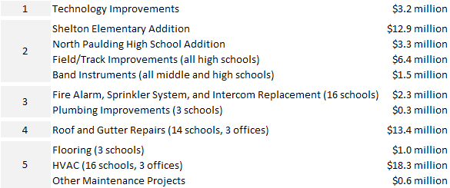
Priority 2: Capital Projects

Slide 10
State Funding of Capital Projects
$18.9 million, or 30%, of the $63.2 million in capital needs are projected to be reimbursed through the Georgia Department of Education’s Capital Outlay Program.
Accountability
Paulding County citizens have consistently partnered with the school district to support critical funding initiatives, such as E-SPLOST. The school district recognizes that the cornerstone of this partnership is excellence in financial stewardship. External auditors have annually reviewed all previous and current programs. All seventeen independent audits have found the school district in full compliance with the Georgia Constitution and Official Code of Georgia.

Slide 11
Thank You For addition information please email SPLOST@paulding.k12.ga.us
Notes:
Tracking data for E-SPLOST V will be published on the district’s website.

